Slide 1
Status report to 92nd GRPE
(March 2025)
Transmitted by the co-chairs
of TF for Tyre Abrasion
Informal document GRPE-92-x
agenda item 7(c)
Task Force on Tyre Abrasion
On behalf of GRBP and GRPE

Slide 2
Task Force on Tyre Abrasion
Targets | Develop a robust procedure for measuring the abrasion of tyres: Test conditions and methods; Define the acceptable uncertainty for the tyre abrasion test method(s) and assess the uncertainty of the tyre abrasion test method; Based on the abrasion test method, define a characterisation of relative mileage potential index; Evaluate the abrasion performance and tread depth reduction of a wide range of tyres available in the market; Define abrasion limits for tyres in order to limit the emission of microplastics to the environment; Develop a proposal of amendment to UN Regulation No 117 for the type approval of tyres in respect to their abrasion.
Roles | Co-chairs: United Kingdom (David.Miles@dft.gov.uk) and European Commission (Vicente.Franco@ec.europa.eu) Secretariat: ETRTO (European Tyre and Rim Technical Organisation)
Reporting | To both working parties: GRPE and GRBP Adoption: GRBP
Web page | Task Force on Tyre Abrasion (TF TA) - Transport - Vehicle Regulations - UNECE Wiki ToRs: TF TA Terms of Reference – Updated at 81st GRBP

Slide 3


Task Force on Tyre Abrasion: facts and figures
Meetings
Attendees ~60
  27th online meeting: 5th November 2024 - https://wiki.unece.org/display/trans/TF+TA+session+27
  28th online meeting: 17th December 2024 - https://wiki.unece.org/display/trans/TF+TA+session+28
  29th online meeting: 29th January 2025 – https://wiki.unece.org/display/trans/TF+TA+session+29
  30th online meeting: 25th February 2025 – https://wiki.unece.org/display/trans/TF+TA+session+30
  31st hybrid meeting (Geneva): 25th March 2025 - https://wiki.unece.org/display/trans/TF+TA+session+31
  CPs:
  European Commission, France, China, Germany, India, Japan, Norway, Netherlands, South Korea, Spain, Switzerland, UK, USA, Canada
  Other organisations:
  ADAC, AVL, ETRMA, ETRTO, HORIBA, IDIADA, ITMA, JAMA, JATMA, LINK, OICA, SMMT, TRAC, TÜV Nord, UBA, UniBW., USTMA, UTAC, VTI, TWMS

Slide 4
Task Force on Tyre Abrasion: work progress
Work on the 2023 test campaign | Validation and correlation test campaign for C1 tyres: Tyres selections (candidate and “reference” tyres) for correlation: done ☑ Tyres selections for alignment: done ☑ Validation test campaign on 3 on-road test centres and 4 drum test centres: done ☑ Alignment test campaign on 7 on-road test centres and 4 drum test centres: done ☑ Post-processing: done ☑ (for the correlation)
Working document | Test conditions and methods for C1 tyres: adopted ☑ GRBP/2024/10 as amended by GRBP-79-12rev2 new supplement to UNR117.04 ☑ Adopted at WP.29 during its 193rd session in June 2024 ECE/TRANS/WP.29/2024/65 ☑
Market assessment for 2024 | For C1: conduct an extensive market assessment test campaign to inform abrasion limit development – nearing completion ◻

Slide 5
Summary of the market assessment (indoor and on-road)
Tyres from across ETRTO, JATMA and ITMA members.
Tyre selection includes wide range of tyre sizes and wet grip and rolling resistance performances.
Market assessment testing to complete in February for on-road method and March for drum method.
JRC is carrying out independent abrasion tests with some more tyres (6 3PMSF + 6 Normal).
 |  | On-road | Drum
Number of tyre models | 3PMSF | 67 | 31
 | Normal | 110 | 69
 | Total | 177 | 100
Number tested so far | 3PMSF | 67 | 31
 | Normal | 109 | 57
 | Total | 176 | 88
Completion Rate | 3PMSF | 100% | 100%
 | Normal | 99% | 82%
 | Total | 99% | 88%
Measurement outputs include among others: i. Abrasion rate, ii. Abrasion index relative to SRTT, iii. Tread depth loss (yet to be received).

Slide 6
Task Force on Tyre Abrasion: Important updates
C1 tyres: ETRTO, JASIC and JRC are undertaking additional methods correlation testing studies between the two methods across 9 different tyre types and 3 to 4 repetitions. Testing completed and results to be shared imminently.
C1: ETRTO commissioned a new multi-circuit evaluation study for the on-road method. This is due to complete by the end of June 2025.
C1: Analysis of market assessment data for C1 3PMSF and normal tyres has commenced within the post-processing sub-group (TAPP).
C1: ETRTO have commenced a study on potential improvements to drum methodology – due to complete by August 2025.
C2 tyres: Testing underway by both ETRTO and JASIC for C2 tyres to feed into method development.
C3 tyres: ETRTO parameter testing for on-road method to begin in February 2025.

Slide 7
Task Force on Tyre Abrasion: Important updates
At the last GRBP session, several CPs proposed that TFTA consider working on a new, separate UN Regulation for tyre abrasion based on considerations put forward by GOIE (informal group of interested experts)
EC expressed reservations on having a separate UNR without a thorough assessment of technical and legal implications
C1: Drafting (on the basis of a new UN Regulation) has commenced in the drafting sub-group (TADG)
EC will support the drafting exercise within TFTA, subject to monitoring developments in relation to the agreed timeline for TFTA deliverables, the legal framework for implementation of Euro 7 on the basis of WP.29 work and ensuring effective implementation at both UNECE and EU level.

Slide 8
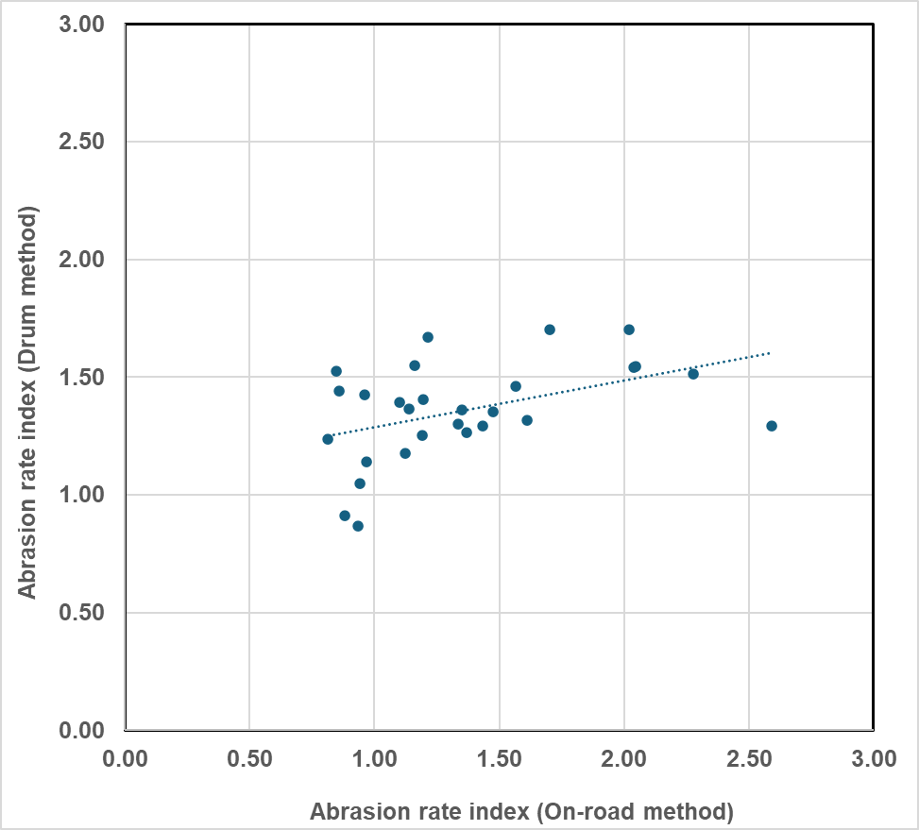
Initial challenges identified from the C1 market assessment
Initial data from analysis of market assessment data for 3PMSF and normal tyres is indicating challenges on correlation between results achieved on the two test methods
Further analysis is being conducted to understand the potential reasons why, including drawing upon data that is made available from ETRTO/JASIC correlation testing
Figure 1: Comparison of abrasion rate indices from the two test methods for equivalent 3PMSF tyres

Slide 9
Task Force on Tyre Abrasion: next steps
C1 tyres | Complete the market assessment campaign – ongoing ◻ Develop proposal for C1 tyre abrasion limits – Working document at GRBP in Sept 2025 ◻ Proposal for online meeting in June to discuss working document submission with GRPE Assess the feasibility of rating and definition of the mileage of tyres -“relative mileage potential calculated performance”- ongoing - Feb September 2025 ◻ Carry out a multi-circuit and multi-drum correlation exercise to verify the correlation between different circuits and drum facilities ◻ Full updated timeline of C1 activities can be found here: TA-30-2
C2 tyres | Assessment of C1 method suitability for C2 tyres – ongoing ◻ Propose abrasion method(s) – working document at GRBP in Feb 2026 Develop proposal for C2 tyre abrasion limits – working document at GRBP in Sept 2027
C3 tyres | Propose abrasion method(s) – working document at GRBP in Feb 2027 Develop proposal for C3 tyre abrasion limits – working document at GRBP in Sept 2029

Slide 10
Thank you

