Slide 1
AVSR-27-01_Rev.1
Automated Driving Systems Marker Lamp
(ADS ML)
Based on document GTB WGSL 691 revision2
GTB
September 2025

Slide 2
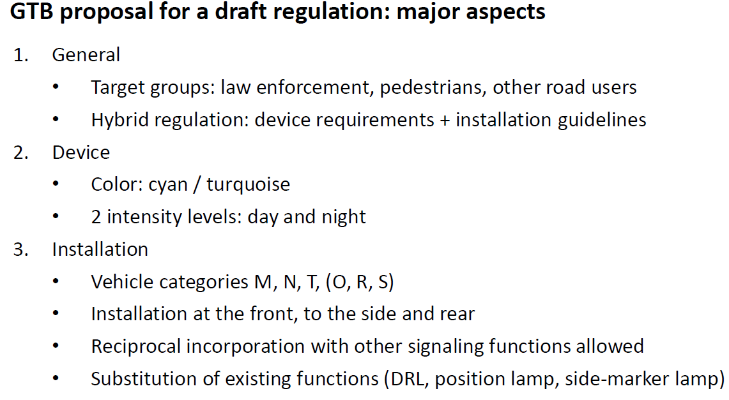
AVSR-27-01_Rev.1
ADS Marker Lamp
Introduction
Light signal to inform the other road users about the autonomous driving system operational status of the vehicle
Extract of the document GRE-90-06 of April 2024
GTB
September 2025

Slide 3
AVSR-27-01_Rev.1
ADS Marker Lamp
Hybrid Regulation - description
General Structure:
    Part I: lamp requirements
    Part II: installation requirements
Definitions:
    Link to the definitions of R48 (R53, R74 and R86).
    New definitions related to ADS marker lamp added
General requirements of R48 added, when relevant for the ADS marker lamp function
Specific new requirements applicable to the ADS marker lamp added
Reference: adopted hybrid UN Regulation No. 165 considered as reference
GTB
September 2025

Slide 4
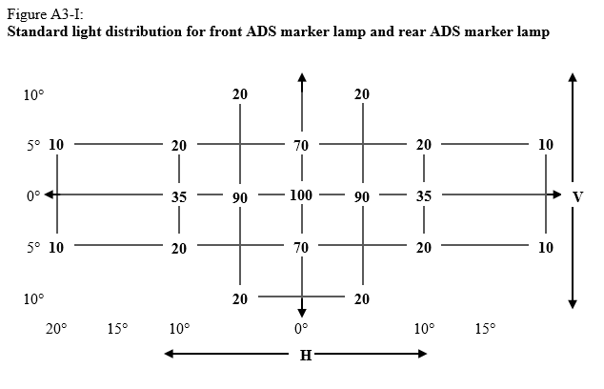
AVSR-27-01_Rev.1
ADS Marker Lamp
Draft Regulation: ADS marker lamp → Draft technical characteristics (1/5)
Front ADS-ML
 |  | DESIGNATED MARKER LAMPS FOR AUTOMATED VEHICLES
Number |  | 1 | 2
Presence |  | mandatory on motor vehicles[, prohibited on trailers]
Photometry | Daytime (min/max) | 50 / 300 cd
 | Nighttime (min/max) | 10 / 125 cd Proposed values by JAPAN: 10 / 42
Geometric visibility | Vertical (up/down) | 15° / 15° (5° down if lower than 750mm) (5° up 30° down if higher that 3000mm)
 | Horizontal (outboard / inboard) | [60° / 60°] | [60° / 45°]
 | To be considered visible | 0.3 cd (day) / 0.05 cd (night)
Mounting (Location) | Height min/max | 250 mm / -
 | Width | Centerline of vehicle | symmetrically placed in relation to the median longitudinal plane
 | Length | - | -
Symbol |  | AV1
Color |  | “blue-green” / “turquoise” x=0.013, y=0.494; x=0.200, y=0.400; x=0.200, y=0.320; x=0.040, y=0.320
Light distribution (photometry grid)
GTB
September 2025

Slide 5
AVSR-27-01_Rev.1
ADS Marker Lamp
Draft Regulation: ADS marker lamp → Draft technical characteristics (2/5)
Rear ADS-ML
 |  | DESIGNATED MARKER LAMPS FOR AUTOMATED VEHICLES
Number |  | 1 | 2
Presence |  | [mandatory/optional on motor vehicles] [, optional for trailers]
Photometry | Daytime (min/max) | [20 / 120 cd]
 | Nighttime (min/max) | 4 / [42] cd
Geometric visibility | Vertical (up/down) | 15° / 15° (5° down if lower than 750mm) (5° up 30° down if higher that 3000mm)
 | Horizontal (outboard / inboard) | [60° / 60°] | [60° / 45°]
 | To be considered visible | 0.3 cd (day) / 0.05 cd (night)
Mounting (Location) | Height min/max | 250 mm / -
 | Width | Centerline of vehicle | symmetrically placed in relation to the median longitudinal plane
 | Length | - | -
Symbol |  | AV2
Color |  | “blue-green” / “turquoise” x=0.013, y=0.494; x=0.200, y=0.400; x=0.200, y=0.320; x=0.040, y=0.320
Light distribution (photometry grid)
GTB
September 2025

Slide 6
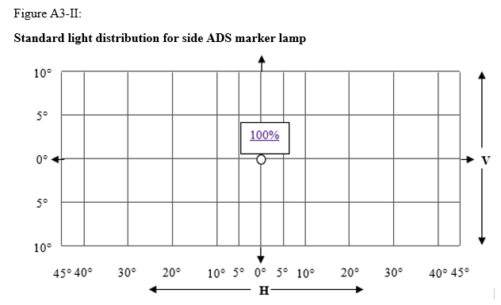
AVSR-27-01_Rev.1
ADS Marker Lamp
Draft Regulation: ADS marker lamp → Draft technical characteristics (3/5)
Side ADS-ML
 |  | DESIGNATED MARKER LAMPS FOR AUTOMATED VEHICLES
Number |  | 1 | 2
Presence |  | mandatory on motor vehicles[, optional for trailers]
Photometry | Daytime (min/max) | [20] / 120 cd
 | Nighttime (min/max) | 4 / 25 cd
Geometric visibility | Vertical (up/down) | 10° / 10° (5 down if lower than 750mm) (5° up 30° down if higher that 3000mm)
 | Horizontal (outboard / inboard) | 45° / 45° | Side front: 45° forward / 30° rearward Side rear: 45° rearward / 30° forward
 | To be considered visible | 3 cd (day) / 0.6 cd (night)
Mounting (Location) | Height min/max | 250 mm / -
 | Width | - | -
 | Length | Side: < 3m from the front | Side front and side rear: < 3m from the front
Symbol |  | AV3
Color |  | “blue-green” / “turquoise” x=0.013, y=0.494; x=0.200, y=0.400; x=0.200, y=0.320; x=0.040, y=0.320
Light distribution (photometry grid)
GTB
September 2025

Slide 7
AVSR-27-01_Rev.1
ADS Marker Lamp
Draft Regulation: ADS marker lamp → Draft technical characteristics (4/5)
 |  | DESIGNATED MARKER LAMPS FOR AUTOMATED VEHICLES
Activation | Other requirements | Switched ON automatically only when the vehicle is in fully automated mode and human input is not expected/required. Switched OFF automatically when the vehicle is not in fully automated mode. Manual switching ON or OFF prohibited. It shall be possible to automatically disable the ADS marker lamps (acc. to UN R-48 par. 5.22., e.g. GPS/software switch) ADS Marker Lamps may be grouped or combined with lamps defined in UN-Regulation No[s]. 48 [or 86], provided that all requirements regarding position, orientation, geometric visibility, electrical connections and other requirements, if any, are fulfilled. Total reciprocal incorporation allowed only with direction indicators Partial reciprocal incorporation allowed with DRL, front position lamps, side marker lamps, direction indicators, rear position lamps. Remaining part of the other UN R-48 function shall comply with the requirements. If a direction indicator is totally or partially reciprocally incorporated with an ADS marker lamp, the ADS marker lamp or the reciprocally incorporated part of it on the relevant side of the vehicle shall be switched OFF during the entire period (both ON and OFF cycle) of activation of the direction-indicator lamp. If a front direction-indicator lamp is not reciprocally incorporated with an ADS marker lamp and the distance between the apparent surfaces ≤ 40mm, special provisions apply (see note (1) in page 8) If the distance between the stop lamp or rear direction indicator and the ADS ML is ≤ 40mm, see remark in page 8 The photometric and colorimetric requirements of an ADS marker lamp shall be fulfilled when all other functions with which this lamp is grouped, combined or reciprocally incorporated are switched OFF.
GTB
September 2025

Slide 8
AVSR-27-01_Rev.1
ADS Marker Lamp
Draft Regulation: ADS marker lamp → Draft technical characteristics (5/5)
Note (1) referenced in page 7:
If the distance between the front direction indicator and the ADS ML is [≤ 40mm] and both lamps are not reciprocally incorporated, special provisions apply:
Proposal of provision to be introduced in the new hybrid regulation ADS-ML, based on UN R-48 par. 6.19.7.6. for not reciprocally incorporated front DI & DRL.
Chosen value 125cd is the night time maximum requirement of the Front ADS-ML
X.X.X. If a front direction-indicator lamp is not reciprocally incorporated with an ADS marker lamp and the distance between the edges of the apparent surfaces in the direction of the reference axis of the front direction-indicator lamp and the ADS marker lamp is equal or less than 40 mm, the electrical connections of the ADS marker lamp shall be such that, either:
(a) The ADS marker lamp on the relevant side of the vehicle is switched OFF during the entire period (both ON and OFF cycle) of operation of the front direction-indicator lamp; or
(b) The luminous intensity of the ADS marker lamp on the relevant side of the vehicle is reduced during the entire period (both ON and OFF cycle) of operation of a front direction-indicator lamp, to attain not more than 125 cd within the angles of geometric visibility. The conformity to this requirement shall be verified at the time of the ADS marker lamp type approval and indicated in the related communication form.
If the luminous intensity of the front direction-indicator lamp in HV is at least 50% higher than the luminous intensity of the ADS marker lamp in HV, the ADS marker lamp does not need to be switched OFF as required under (a) of this paragraph nor dimmed as required under (b) of this paragraph. In this case the applicant shall demonstrate compliance with a concise description or other means acceptable to the Type Approval Authority.
Note: discussion regarding this point still on-going at GTB. Similar discussion for rear direction indicator and stop lamp.
GTB
September 2025

