Slide 1
IWG-EMC-49-07
Proposal by CLEPA:
Clarification of ESA charging conditions
(IWG-EMC-46-11/12 Flowchart proposal Follow-up)

Slide 2
Background & Rational
IWG-EMC-49-07
A flowchart was added in R10.07 to clarify the charging mode configuration for vehicles.
However, such clarification is still not yet available for ESAs.
Test Description | Vehicle |  | ESA
Broadband radiated emission | Annex 4 | Defined in a clear flowchart | Annex 7 | Not clearly defined
Radiated immunity | Annex 6 | Defined in a clear flowchart | Annex 9 | Not clearly defined
Emission of harmonics generated on AC power lines | Annex 11 | Defined in a clear flowchart | Annex 17 | Not clearly defined
Emission of voltage changes, fluctuations and flicker on AC power lines | Annex 12 | Defined in a clear flowchart | Annex 18 | Not clearly defined
Emission of radiofrequency conducted disturbances on AC or DC power lines | Annex 13 | Defined in a clear flowchart | Annex 19 | Not clearly defined
Immunity of Electrical Fast Transient/Burst disturbances conducted along AC and DC power lines | Annex 15 | Defined in a clear flowchart | Annex 21 | Not clearly defined
Immunity of surges conducted along AC and DC power lines | Annex 16 | Defined in a clear flowchart | Annex 22 | Not clearly defined
NOTE: The scope of this table is limited to test conditions relevant to REESS charging mode only.
During the 46th IWG-EMC session, CLEPA presented a flowchart proposal for ESA, following the same concept as vehicle flowchart. (IWG-EMC-46-11/12)
Based on the feedback received from that meeting, CLEPA has now prepared two alternative options to improve the clarity of ESA charging mode configuration:
OPTION 1
Text-based Clarification
OPTION 2
Flowchart-based Clarification

Slide 3
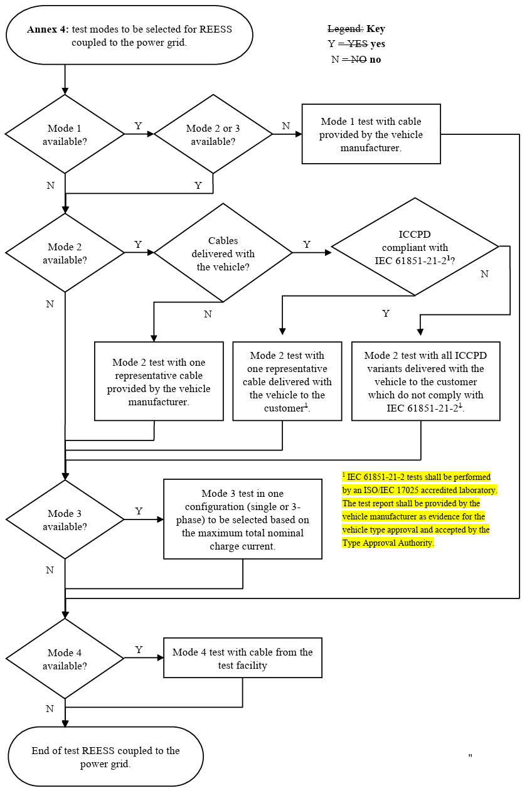
OPTION 1: Text-Based Clarification (1/3)
OPTION 1
IWG-EMC-49-07
Example - Charging mode flowchart for Vehicle
Original Wording (Vehicle)
Proposed Wording (ESA)
Mode 3 test in one configuration (single or 3-phase) to be selected based on maximum total nominal charge current
AC charging test on ESA shall be conducted in one configuration (Single or 3-phase), selected based on maximum total nominal charge current
Mode 4 test with cable from the test facility
DC charging test on ESA shall be conducted with cable from test facility
Source : GRE-92-24 - (IWG EMC) Proposal to supersede ECE/TRANS/WP.29/GRE/2025/3

Slide 4
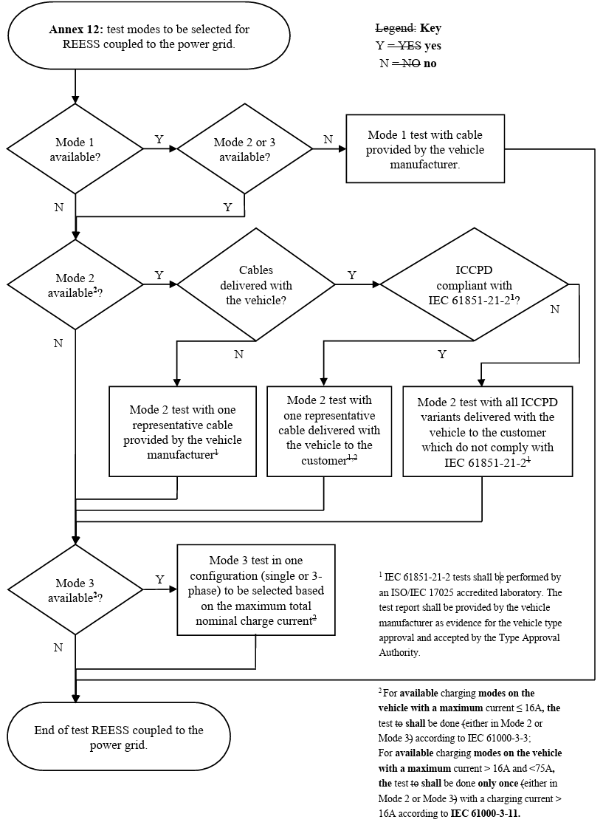
OPTION 1: Text-Based Clarification (2/3)
OPTION 1
IWG-EMC-49-07
Example - Charging mode flowchart for Vehicle
Original Wording (Vehicle)
Proposed Wording (ESA)
² For available charging modes on the vehicle with a maximum current ≤ 16A, the test shall be done either in Mode 2 or Mode 3 according to IEC 61000-3-2;
For available charging modes on the vehicle with a maximum current > 16A and <75A, the test shall be done only once either in Mode 2 or Mode 3 with a charging current > 16A according to IEC 61000-3-12.
For ESA in AC charging mode with a maximum current ≤ 16A, the test shall be done according to IEC 61000-3-2;
For ESA in AC charging mode with a maximum current > 16A and <75A, the test shall be done only once with a charging current > 16A according to IEC 61000-3-12.
Source : GRE-92-24 - (IWG EMC) Proposal to supersede ECE/TRANS/WP.29/GRE/2025/3

Slide 5
OPTION 1: Text-Based Clarification (3/3)
OPTION 1
IWG-EMC-49-07
Proposed Wording to be added to each Annex by ESA test item
ESA Test Item | Annex No. | Text to be added
Broadband radiated emission | Annex 7 | AC charging test on ESA shall be conducted in one configuration (Single or 3-phase), selected based on maximum total nominal charge current. DC charging test on ESA shall be conducted with cable from test facility.
Radiated immunity | Annex 9 | AC charging test on ESA shall be conducted in one configuration (Single or 3-phase), selected based on maximum total nominal charge current. DC charging test on ESA shall be conducted with cable from test facility
Emission of harmonics generated on AC power lines | Annex 17 | AC charging test on ESA shall be conducted in one configuration (Single or 3-phase), selected based on maximum total nominal charge current. For ESA in AC charging mode with a maximum current ≤ 16A, the test shall be done according to IEC 61000-3-2; For ESA in AC charging mode with a maximum current > 16A and <75A, the test shall be done only once with a charging current > 16A according to IEC 61000-3-12.
Emission of voltage changes, fluctuations and flicker on AC power lines | Annex 18 | AC charging test on ESA shall be conducted in one configuration (Single or 3-phase), selected based on maximum total nominal charge current. For ESA in AC charging mode with a maximum current ≤ 16A, the test shall be done according to IEC 61000-3-3; For ESA in AC charging mode with a maximum current > 16A and <75A, the test shall be done only once with a charging current > 16A according to IEC 61000-3-11.
Emission of radiofrequency conducted disturbances on AC or DC power lines | Annex 19 | AC charging test on ESA shall be conducted in one configuration (Single or 3-phase), selected based on maximum total nominal charge current. DC charging test on ESA shall be conducted with cable from test facility.
Immunity of Electrical Fast Transient/Burst disturbances conducted along AC and DC power lines | Annex 21 | AC charging test on ESA shall be conducted in one configuration (Single or 3-phase), selected based on maximum total nominal charge current. DC charging test on ESA shall be conducted with cable from test facility.
Immunity of surges conducted along AC and DC power lines | Annex 22 | AC charging test on ESA shall be conducted in one configuration (Single or 3-phase), selected based on maximum total nominal charge current. DC charging test on ESA shall be conducted with cable from test facility.

Slide 6
OPTION 2: Flowchart-Based Clarification (1/3)
OPTION 2
IWG-EMC-49-07
Example - Charging mode flowchart for Vehicle
Original Wording (Vehicle)
Proposed Wording (ESA)
Annex Number : test modes to be selected for REESS coupled to the power grid.
Mode 3 test in one configuration (single or 3-phase) to be selected based on maximum total nominal charge current
AC charging test on ESA in only one configuration (single or 3-phase), selected based on maximum total nominal charge current
AC charging available?
Y
N
Mode 4 test with cable from the test facility
DC charging available?
Y
DC charging test on ESA with cable from the test facility
N
End of test REESS coupled to the power grid.
Source : GRE-92-24 - (IWG EMC) Proposal to supersede ECE/TRANS/WP.29/GRE/2025/3

Slide 7
OPTION 2: Flowchart-Based Clarification (2/3)
OPTION 2
IWG-EMC-49-07
Example - Charging mode flowchart for Vehicle
Original Wording (Vehicle)
Proposed Wording (ESA)
² For available charging modes on the vehicle with a maximum current ≤ 16A, the test shall be done either in Mode 2 or Mode 3 according to IEC 61000-3-2;
For available charging modes on the vehicle with a maximum current > 16A and <75A, the test shall be done only once either in Mode 2 or Mode 3 with a charging current > 16A according to IEC 61000-3-12.
Annex Number : test modes to be selected for REESS coupled to the power grid.
AC charging test on ESA in only one configuration (single or 3-phase), selected based on maximum total nominal charge current
AC charging available?
Y
N
Maximum charging current > 16A and <75A ?
N
Y
Test according to IEC 61000-3-2 (or 3)
Test according to IEC 61000-3-12 (or 11)
End of test REESS coupled to the power grid.
Source : GRE-92-24 - (IWG EMC) Proposal to supersede ECE/TRANS/WP.29/GRE/2025/3

Slide 8
OPTION 2: Flowchart-Based Clarification (3/3)
OPTION 2
IWG-EMC-49-07
Proposed Flowchart to be added to each Annex by ESA test item
ESA Test Item | Annex No. | Flowchart type to be added
Broadband radiated emission | Annex 7 | Type 1
Radiated immunity | Annex 9 | Type 1
Emission of harmonics generated on AC power lines | Annex 17 | Type 2
Emission of voltage changes, fluctuations and flicker on AC power lines | Annex 18 | Type 2
Emission of radiofrequency conducted disturbances on AC or DC power lines | Annex 19 | Type 1
Immunity of Electrical Fast Transient/Burst disturbances conducted along AC and DC power lines | Annex 21 | Type 1
Immunity of surges conducted along AC and DC power lines | Annex 22 | Type 1
Type 1
Type 2
Annex Number : test modes to be selected for REESS coupled to the power grid.
Annex Number : test modes to be selected for REESS coupled to the power grid.
AC charging available?
Y
AC charging test on ESA in only one configuration (single or 3-phase), selected based on maximum total nominal charge current
AC charging available?
Y
AC charging test on ESA in only one configuration (single or 3-phase), selected based on maximum total nominal charge current
N
N
N
Maximum charging current >16A and <75A ?
Y
DC charging available?
Y
DC charging test on ESA with cable from the test facility
N
Test according to IEC 61000-3-2 (or 3)
Test according to IEC 61000-3-12 (or 11)
End of test REESS coupled to the power grid.
End of test REESS coupled to the power grid.

Slide 9
Summary and Outlook
IWG-EMC-49-07
Two alternative options are proposed to clarify the ESA charging mode configuration:
Both options are intended to maintain alignment with the vehicle structure defined in UN R10.07, while keeping the scope strictly ESA-only.
At this stage, the proposal mirrors the existing vehicle flowchart from UN R10.07 and applies the same structure to ESA.
Additional test conditions — such as charging currents above 75 A or new charging technologies — will be reviewed and incorporated once the corresponding standards are established.
The proposal therefore focuses on establishing a clear, consistent, and harmonized configuration for ESA charging-mode testing, fully aligned with the framework already implemented for vehicles under UN R10.07.
OPTION 1
Text-based Clarification
OPTION 2
Flowchart-based Clarification
The author and the speaker of this presentation confirm that they have authorization to use all content including photos and visual elements.
The material is either copyright-free or the author/speaker hold the necessary copyright or permission.
The UNECE will remove any material from its events and supporting websites if there is unlawful use of copyrighted material.
The author/speaker takes responsibility for any infringement on copyright and holds the UNECE harmless to this effect.

